Slide 1

Red-Black Tree-Based Dynamic Flow Management in IDS/IPS
COHNDNE252F-004 K.A Baylon
COHNDNE252F-005 S.M.J Nawarathna
COHNDNE252F-007 J A K C Jayasinghe

Slide 2

INTRODUCTION

Slide 3

core challenge
Network flows are dynamically created, frequently updated, and rapidly terminated. Therefore, an efficient data management mechanism is essential to maintain real-time detection accuracy.
The system detects abnormal patterns such as:
Distributed Denial-of-Service (DoS) attacks
Port scanning attempts
Lateral movement within the network
Long-lived suspicious sessions

Slide 4
Selected data structure : red – black tree
A Red-Black Tree is a self-balancing Binary Search Tree that maintains near-perfect balance using node coloring rules and tree rotations.
The structure guarantees the following time complexities:
Search → O(log n)
Insert → O(log n)
Delete → O(log n)

Slide 5
Selected data structure : red – black tree
IDS/IPS systems require extremely fast lookups to match packets with existing flows.
The O(log n) search time of a Red-Black Tree ensures efficient packet classification even when thousands of flows are active.
Hash Tables
Do not maintain natural ordering
Can suffer performance degradation due to collisions
Not suitable for range-based anomaly detection
AVL Trees
Require frequent rotations during updates
Higher maintenance overhead under heavy traffic

Slide 6
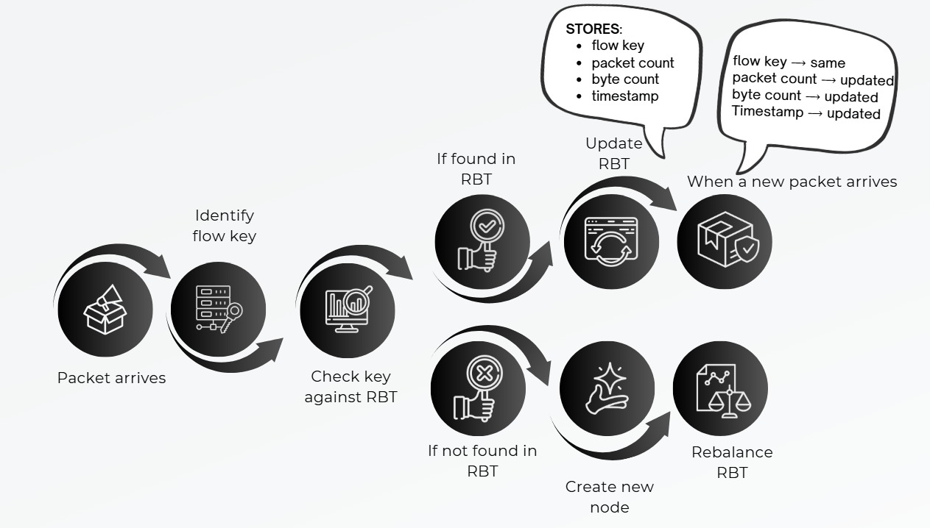
Conceptual Operation

Slide 7
FLOW KEY OPERATION
Source IP
Destination IP
Source port
Destination port
Protocol
192.168.20.100
8.8.8.8
5000
53
UDP
192.168.20.100 → 8.8.8.8
Port 5000 → 53
Protocol → UDP
Becomes one key
(Flow Key)

Slide 8
Intrusion detection
Statistic | Normal behavior | Attack behavior | Type of attack
Packet count | 50 - 200 | 50,000+ in secs | DoS attack
Byte count | Few KB or MB | Excessive size data transfer | Exfiltration attack
Session duration | Few seconds | Several hours | Malicious behavior
Number of flow keys | Few keys from single IP source | Same source IP 100+ new flow keys | Port scanning
Once Malicious behavior is detected the IPS system acts
1. Identify flow key
2. Add firewall rule to block it
3. Stop processing packets
4. Optionally remove node from tree = RBT delete operation

Slide 9
Flow expiration & memory protection
In high-traffic networks, inactive flows must be removed to prevent memory exhaustion. Periodic cleanup processes identify idle flows based on timeout thresholds. Flow expiration can be explained as the Periodic cleanup processes to identify idle flows based on timeout thresholds. The Red-Black Tree deletion operation ensures that removing nodes does not disturb tree balance.
This controlled deletion process protects the IDS/IPS from:
State exhaustion attacks
SYN flood attacks
Memory overflow conditions
Balanced deletion guarantees long-term system stability and resilience against resource-based attacks

Slide 10
Effectiveness of the solution
The Red-Black Tree provides several advantages in dynamic networking environments:
Predictable O(log n) performance
Efficient handling of frequent insertions and deletions
Orderd traversal capability for traffic analysis
Scalability for enterprise-scale deployment

Slide 11

conclusion

